Slide 1
Annual Report
2019-20

Slide 2
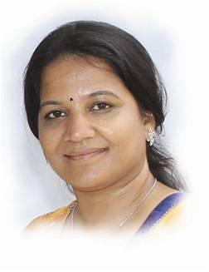
From the Director’s Desk
We believe in imparting good values, holistic and joyous learning .
Ms.G.Sunitha Rani

Slide 3
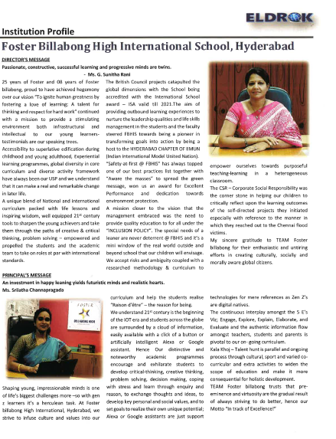
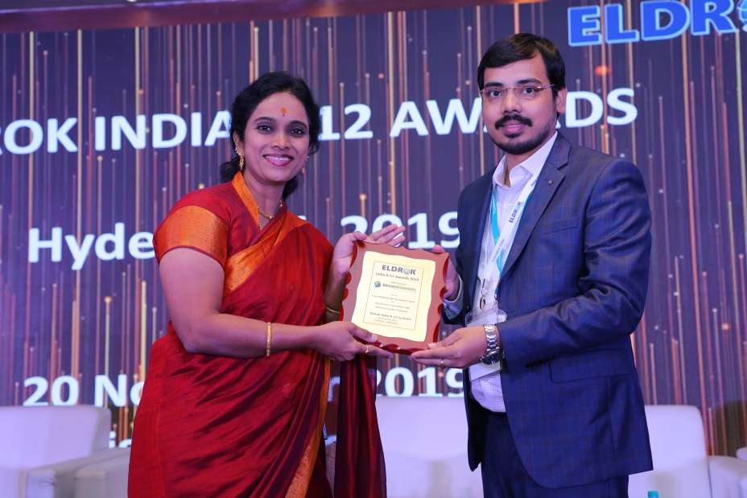
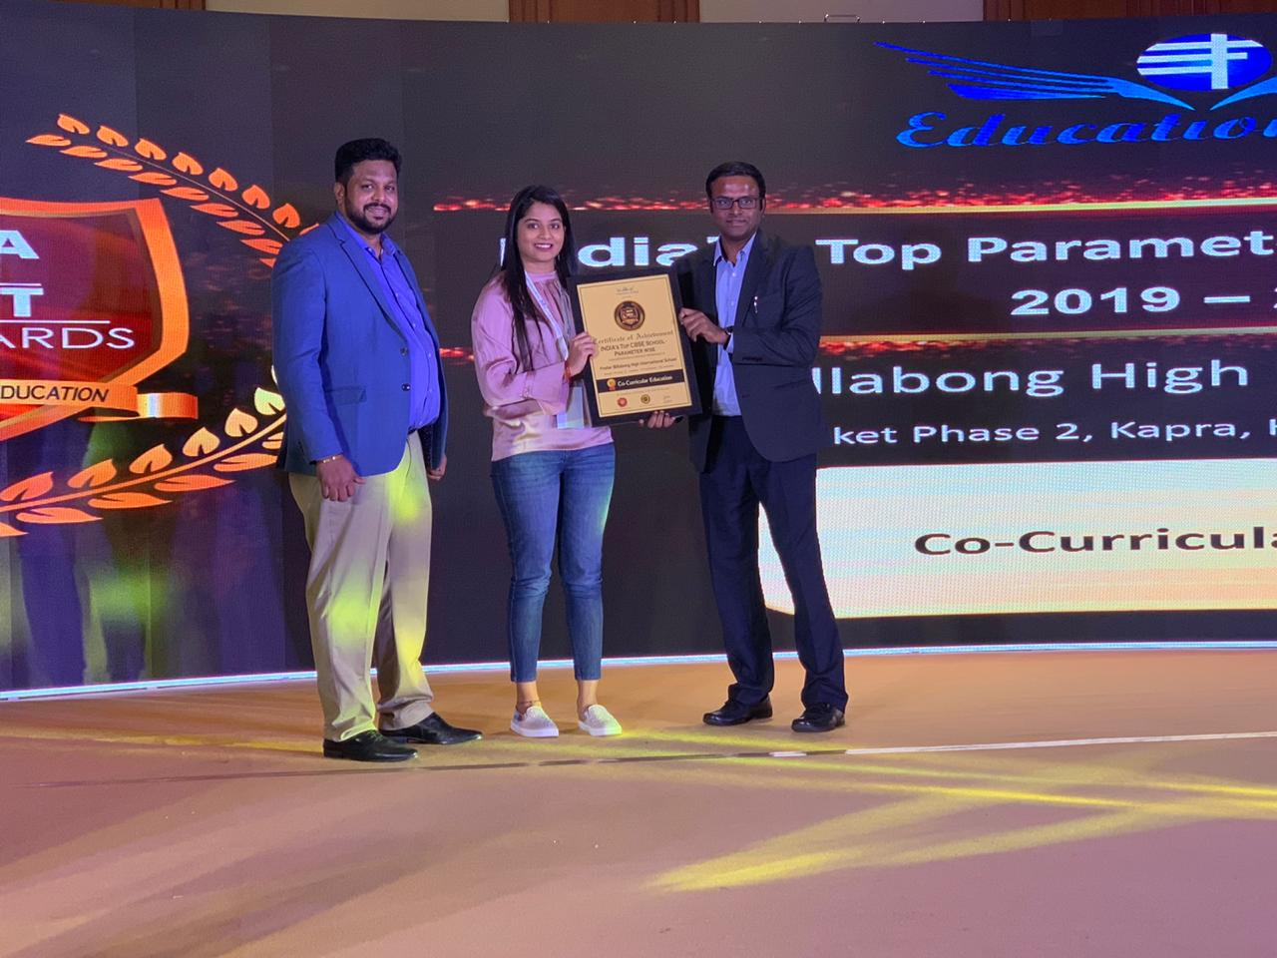
Achievements and Accolades

Slide 4
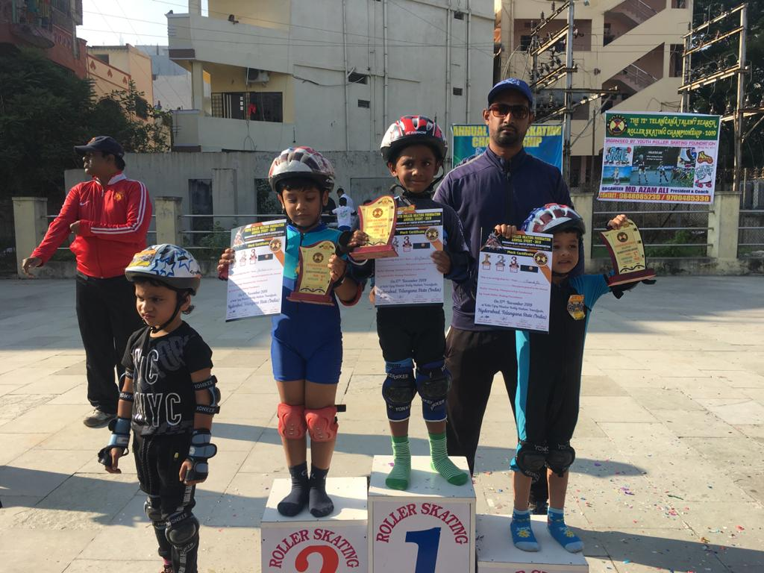
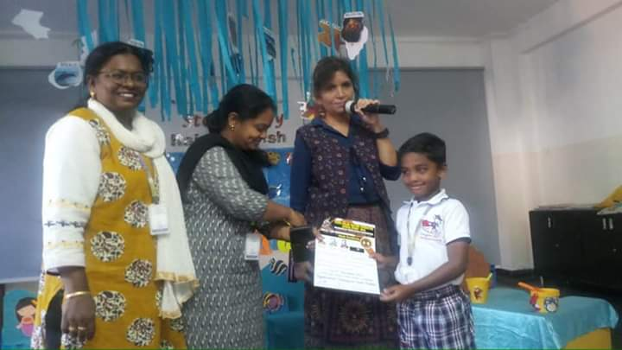
Preschool Achievements and Accolades
17.11.2019

Slide 5
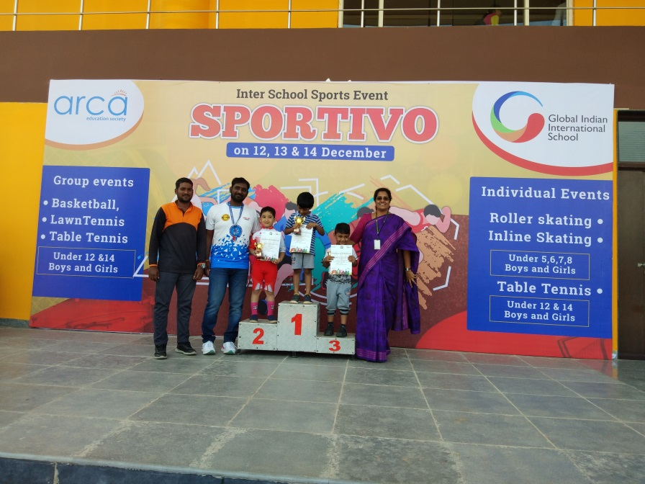
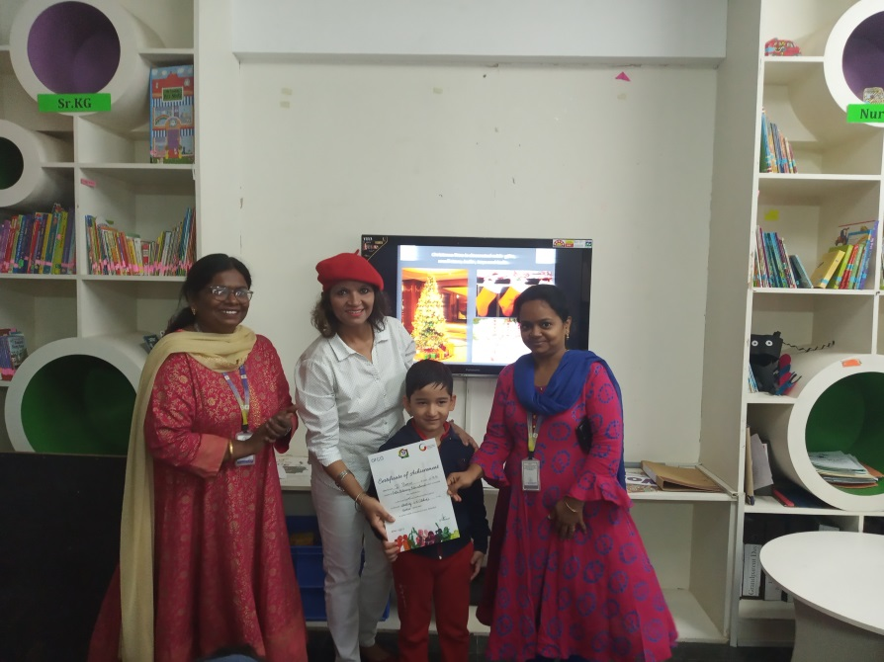
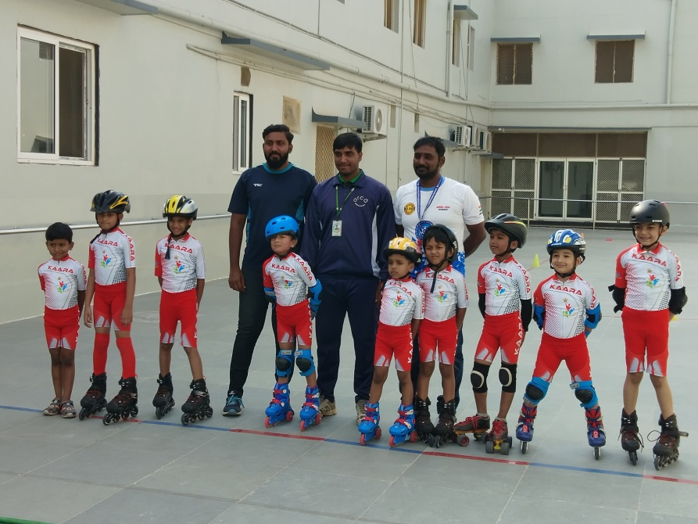
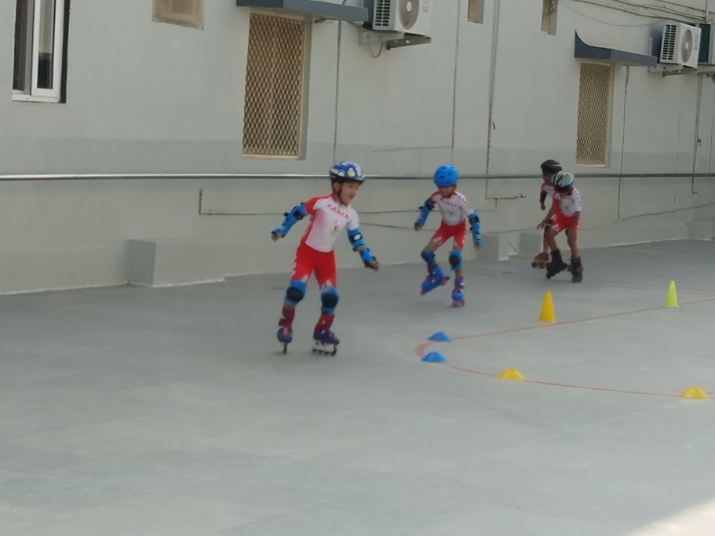
Preschool Achievements and Accolades
14.12.2019

Slide 6
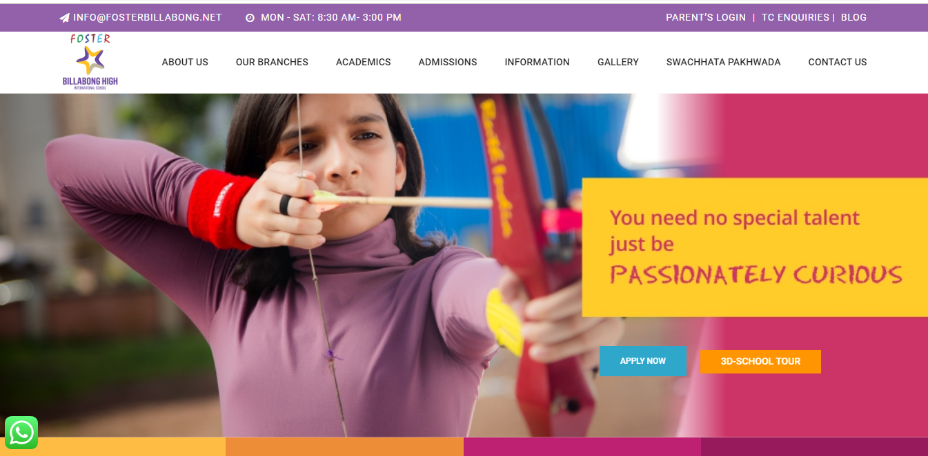
Website Portal and Connecting with us

Slide 7
Exuberance – E zine

Slide 8
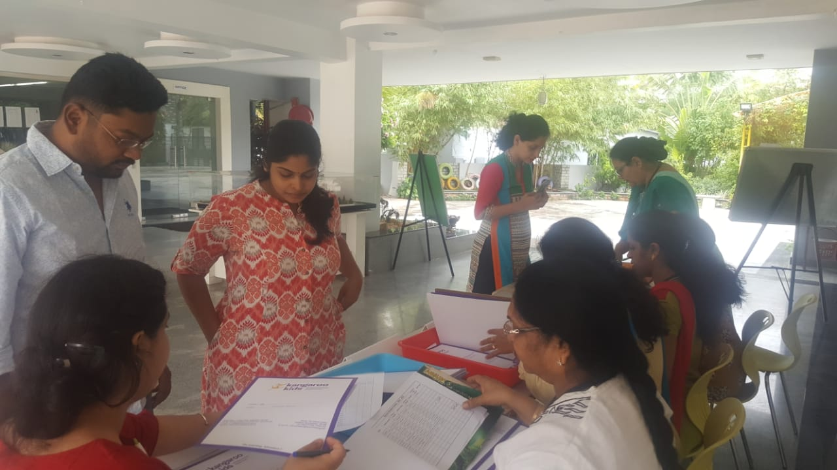
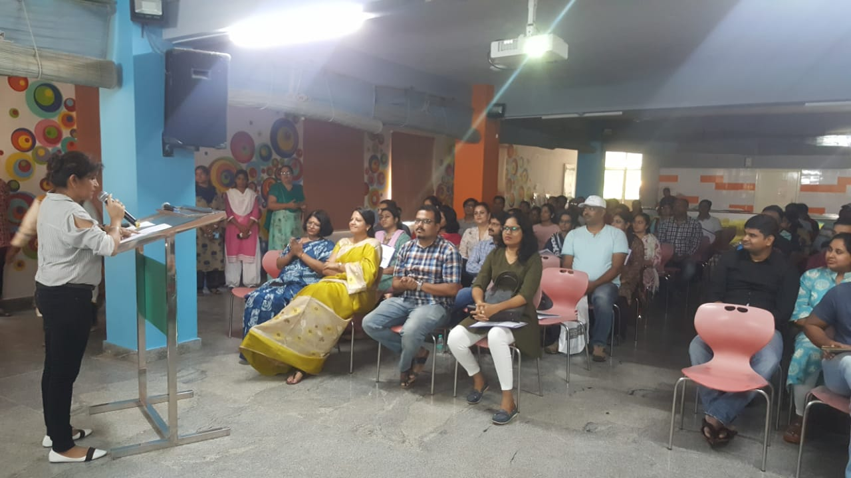
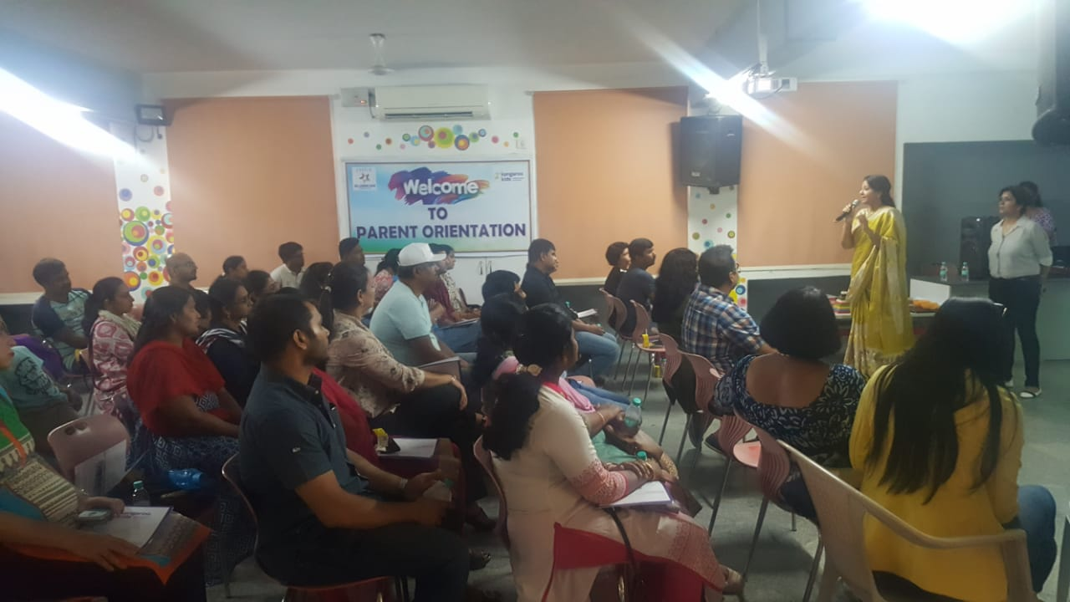
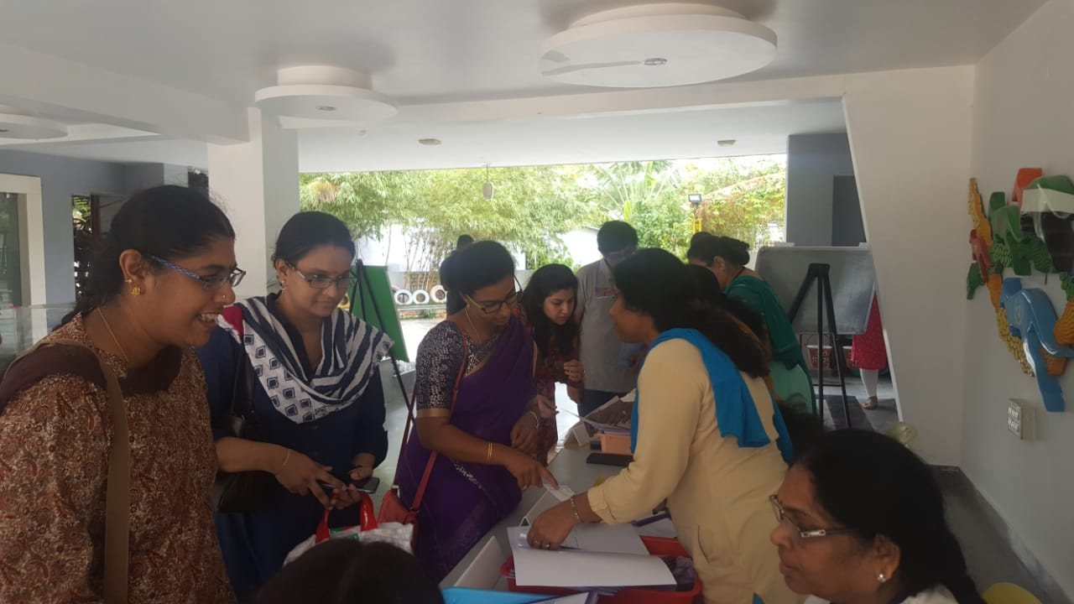
Parent Orientation 8.6.2019

Slide 9
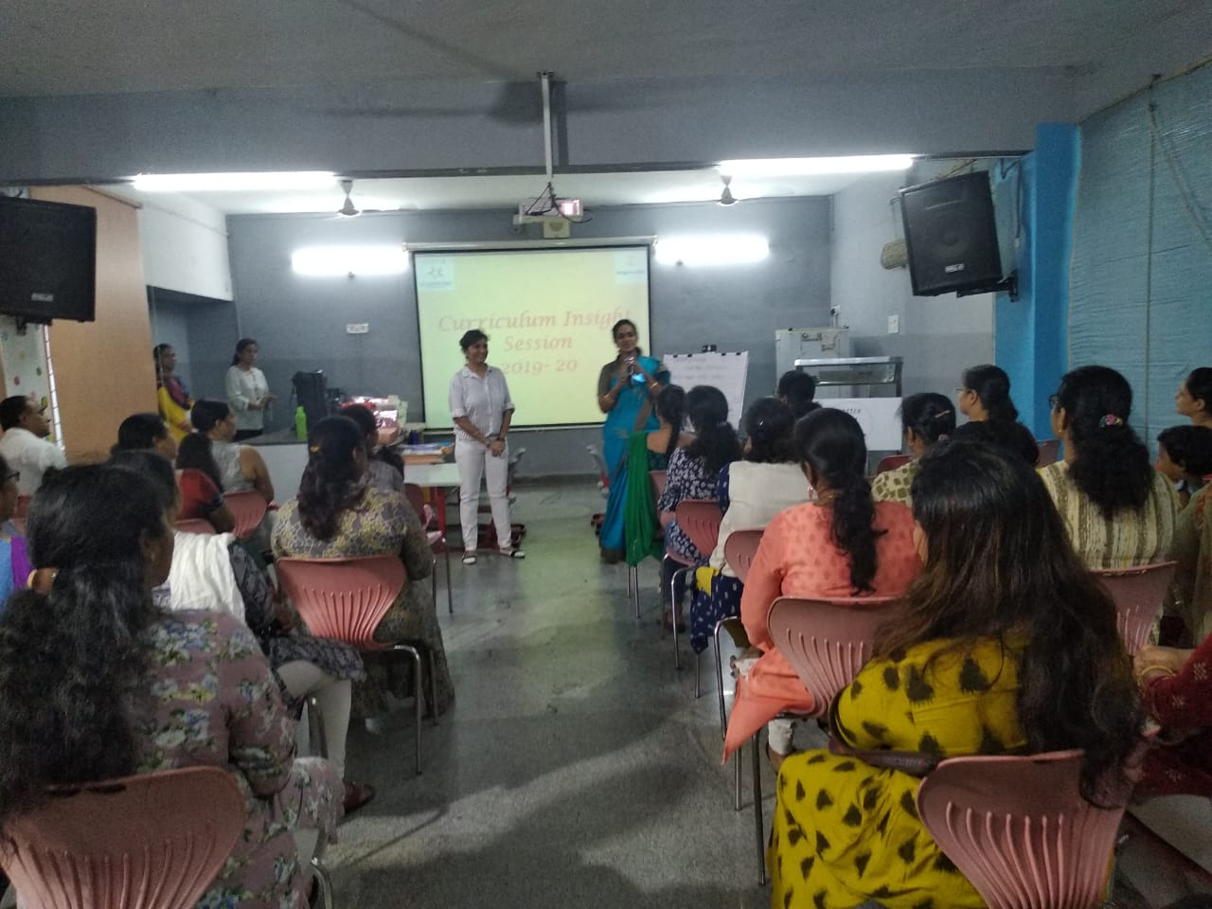
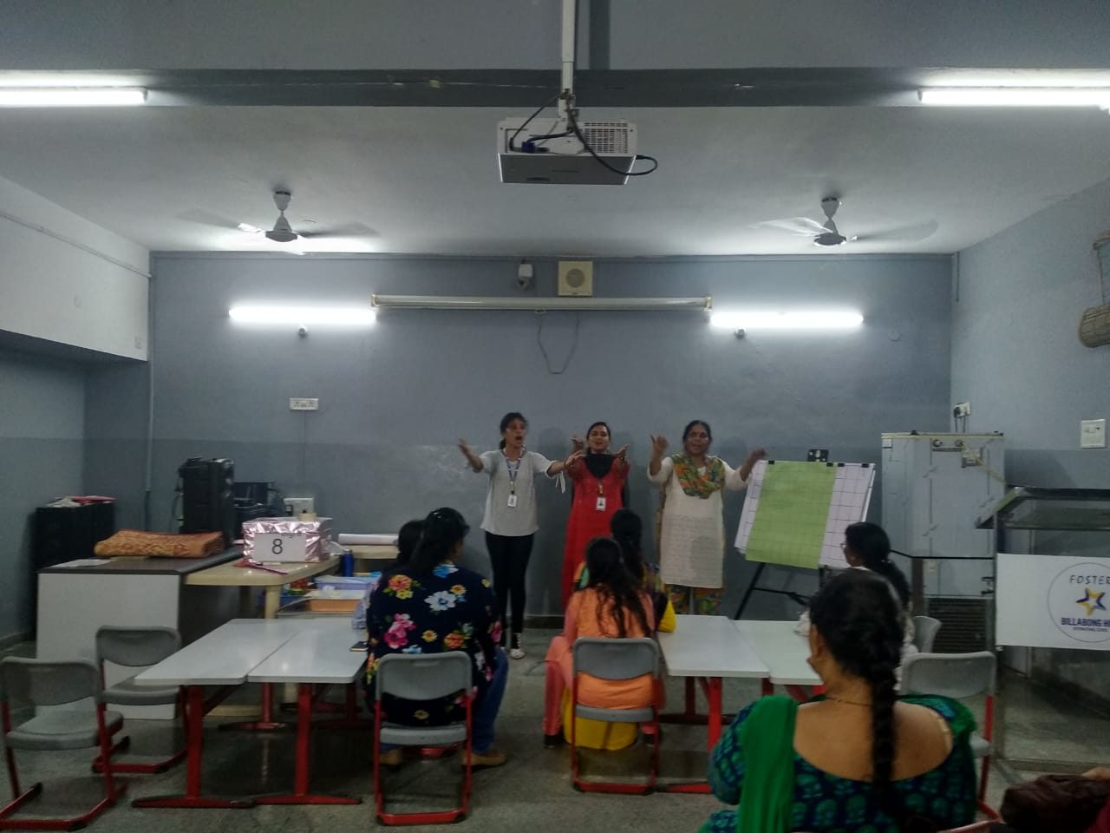
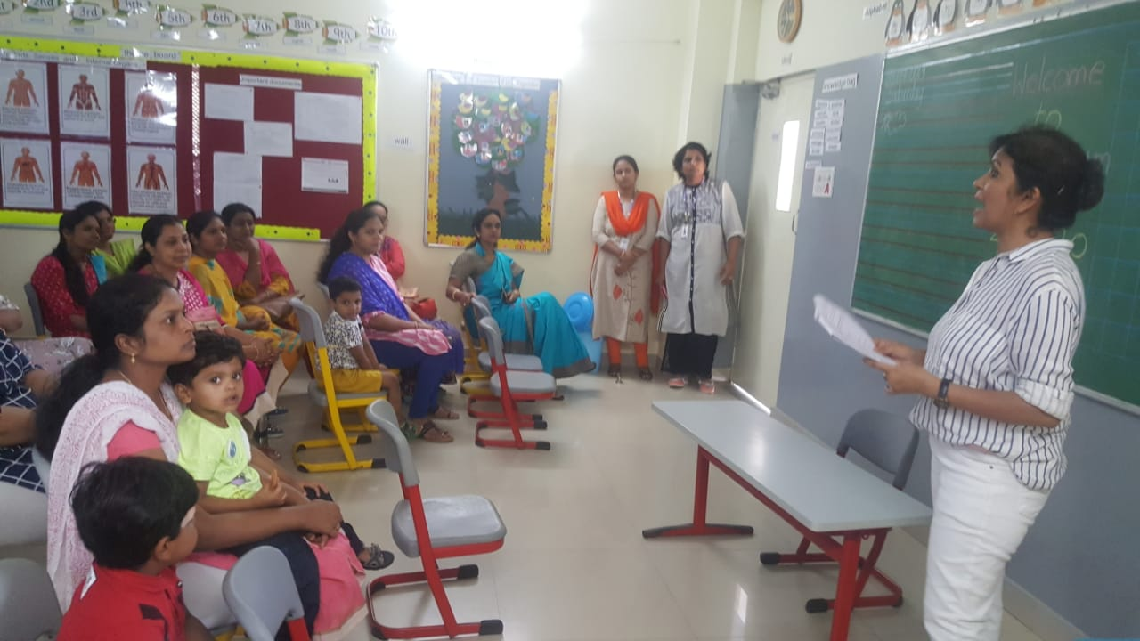
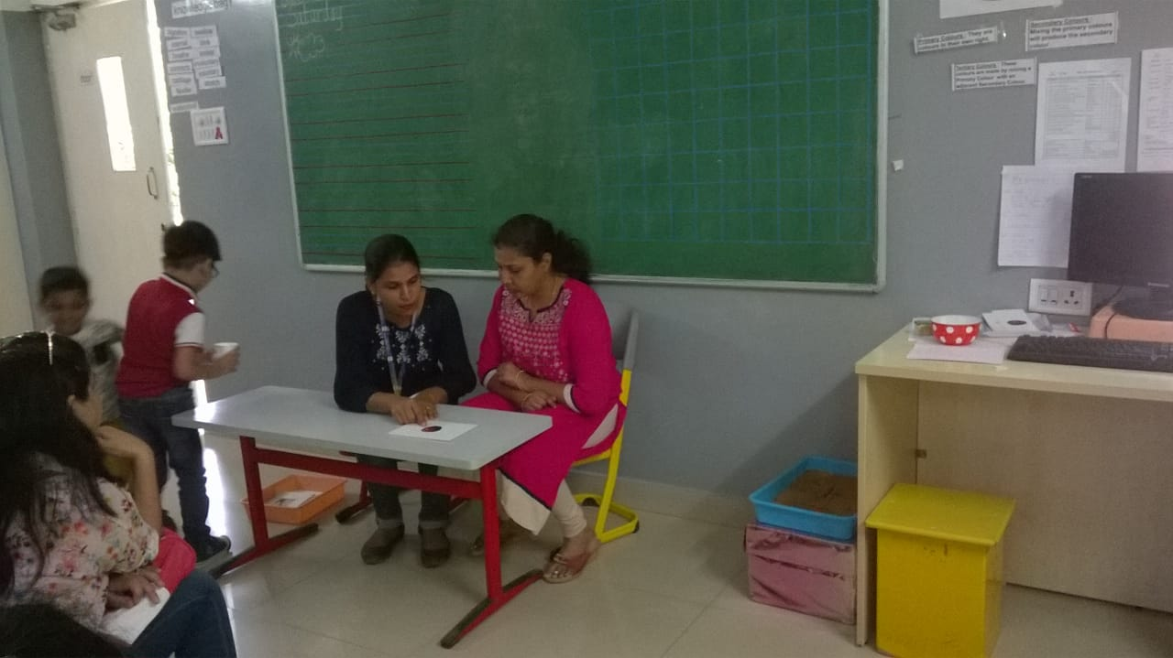
Curriculum Insight Session 20.7.2019

Slide 10
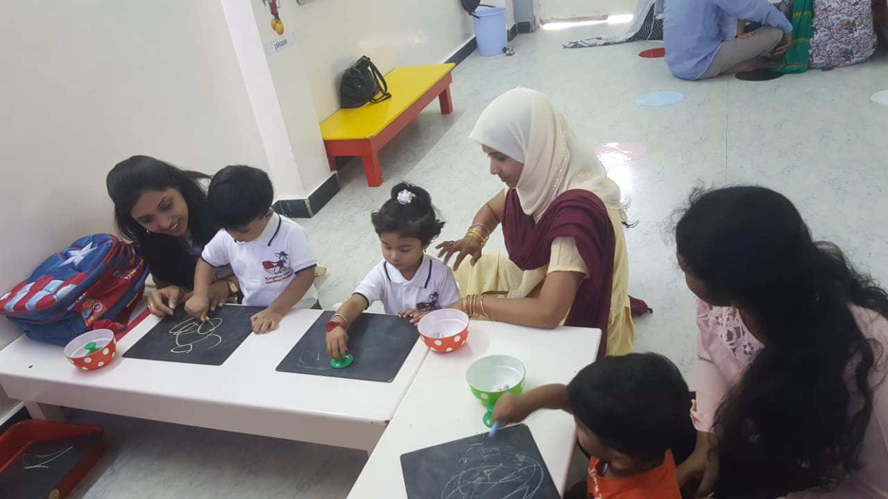
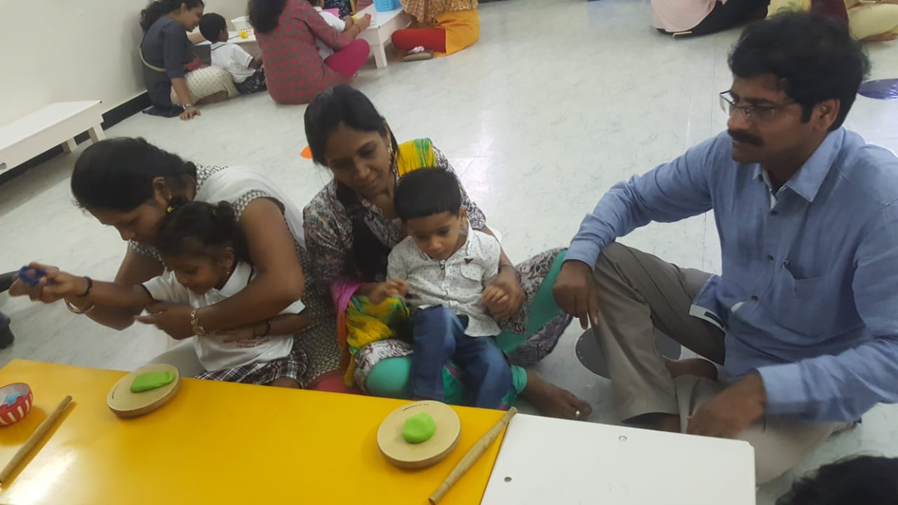
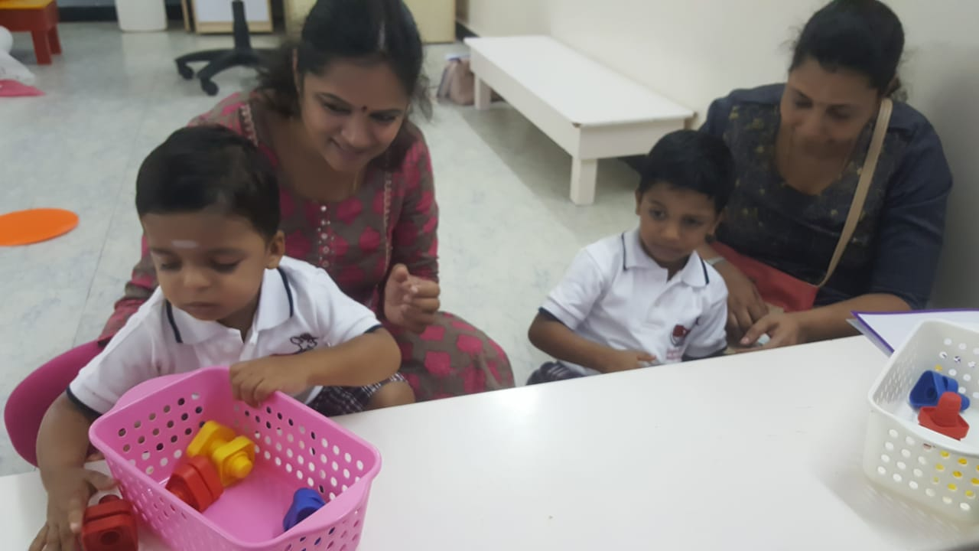
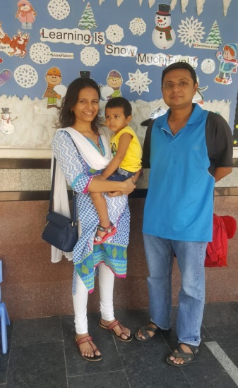
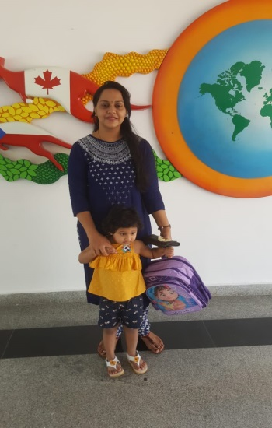
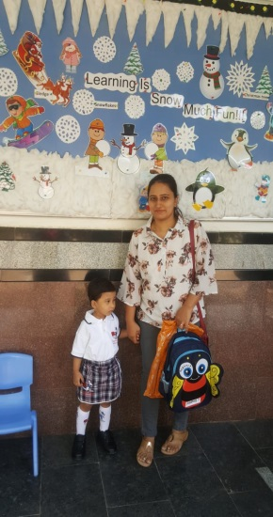
Nursery
First Day of School & Settling time with parents

Slide 11
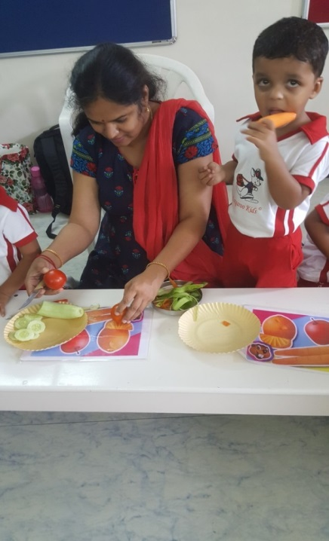
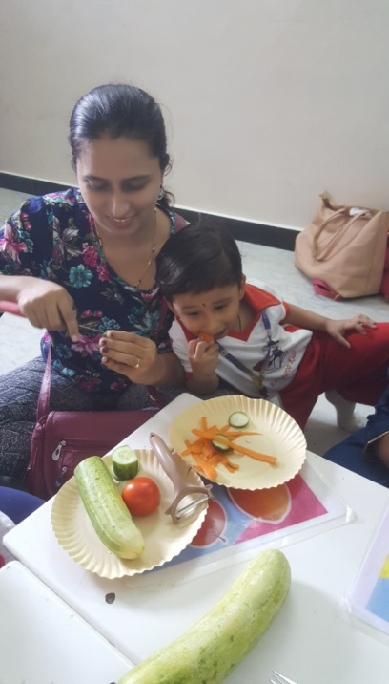
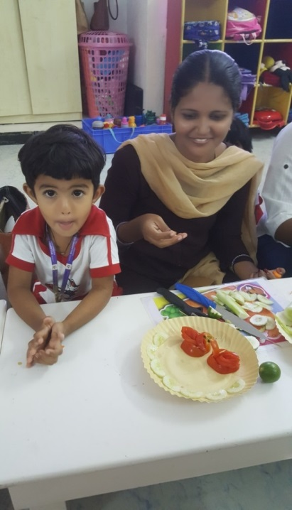
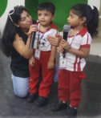
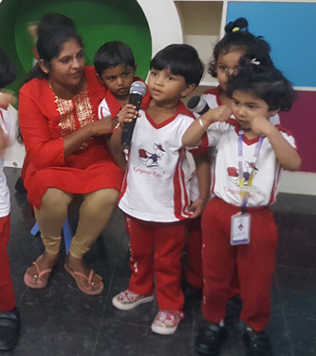
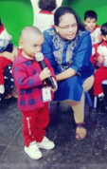
Nursery
Veggie Salad Day & Karaoke Day 27.9.2019

Slide 12
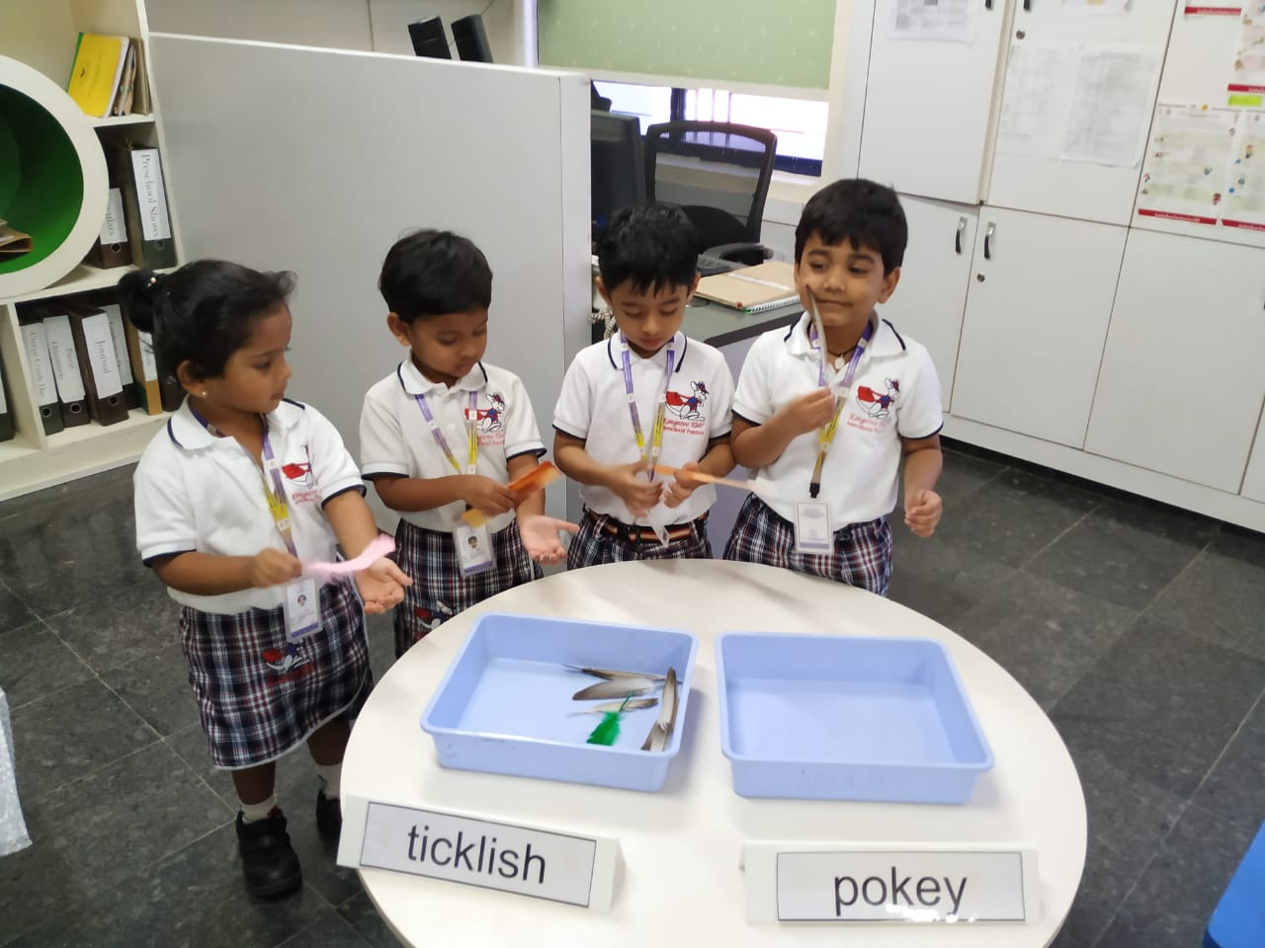
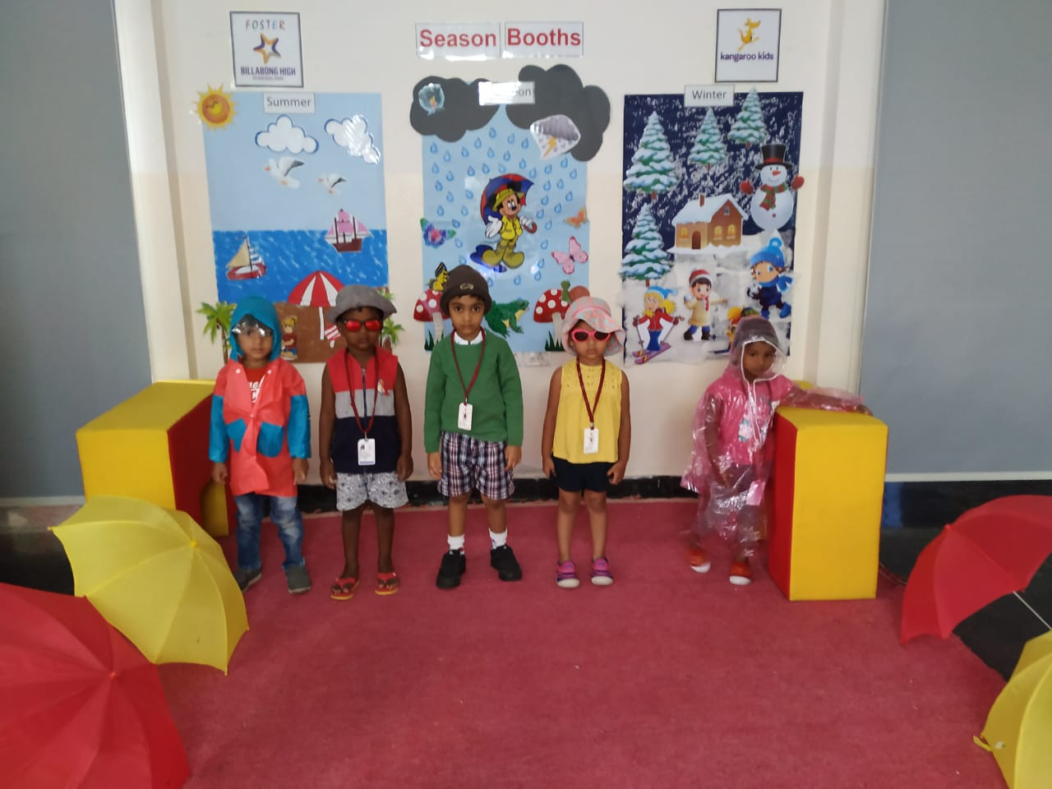
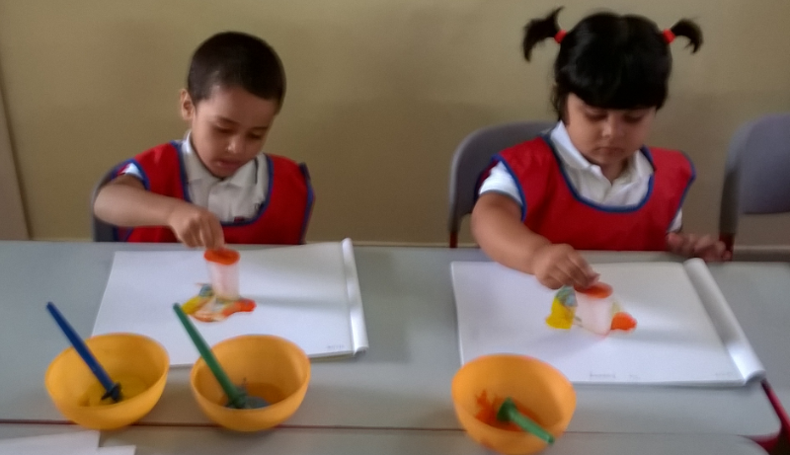
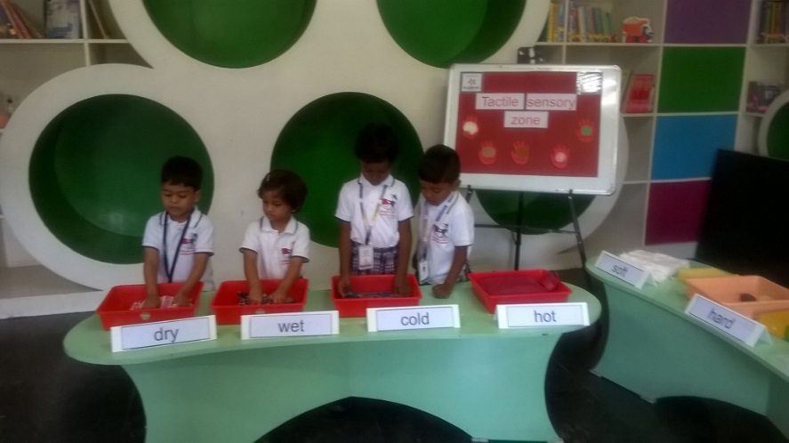
Jr.KG – Seasons Booth & Tactile Sensory Zone

Slide 13
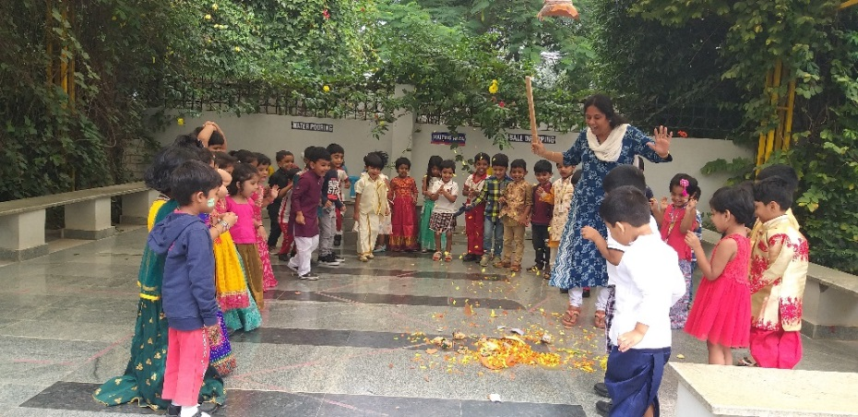
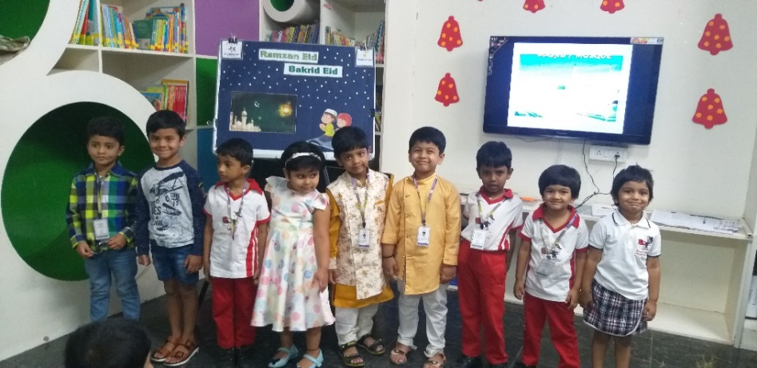
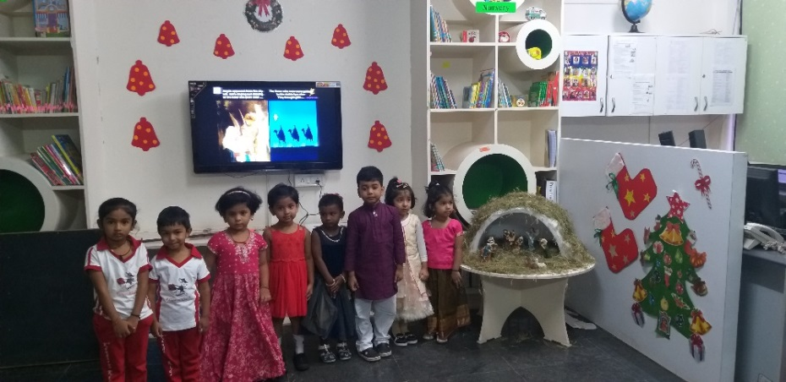
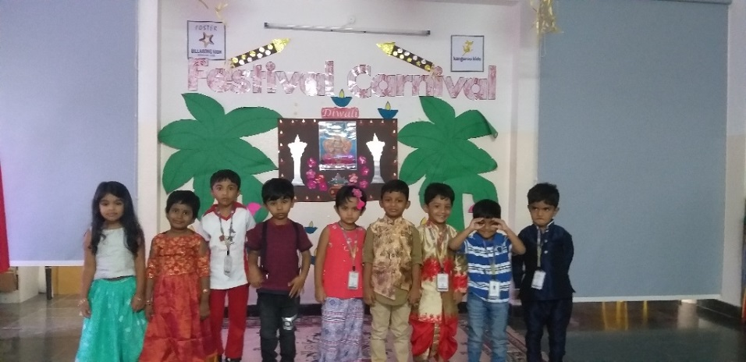
Jr.KG – Festival Carnival
15.11.2019

Slide 14
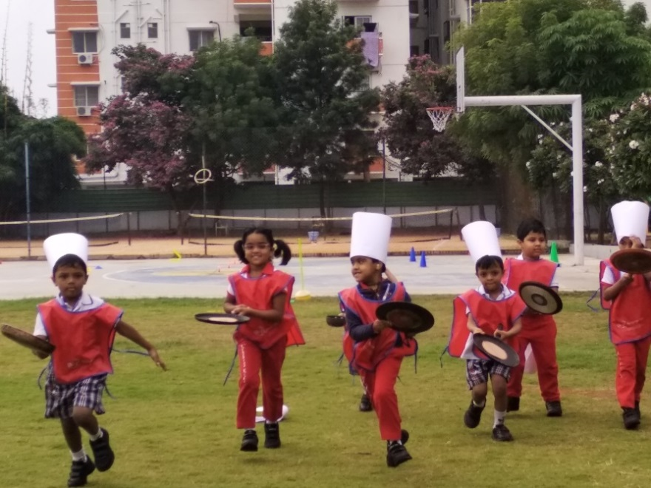
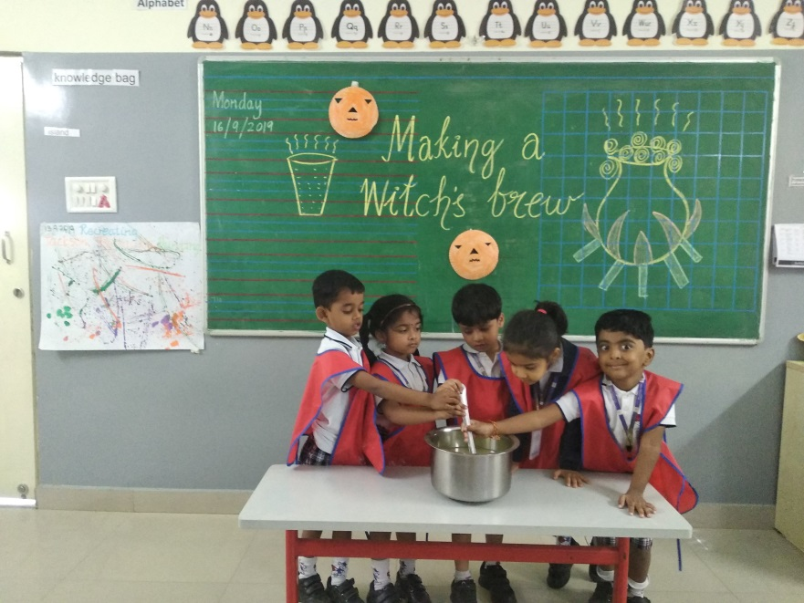
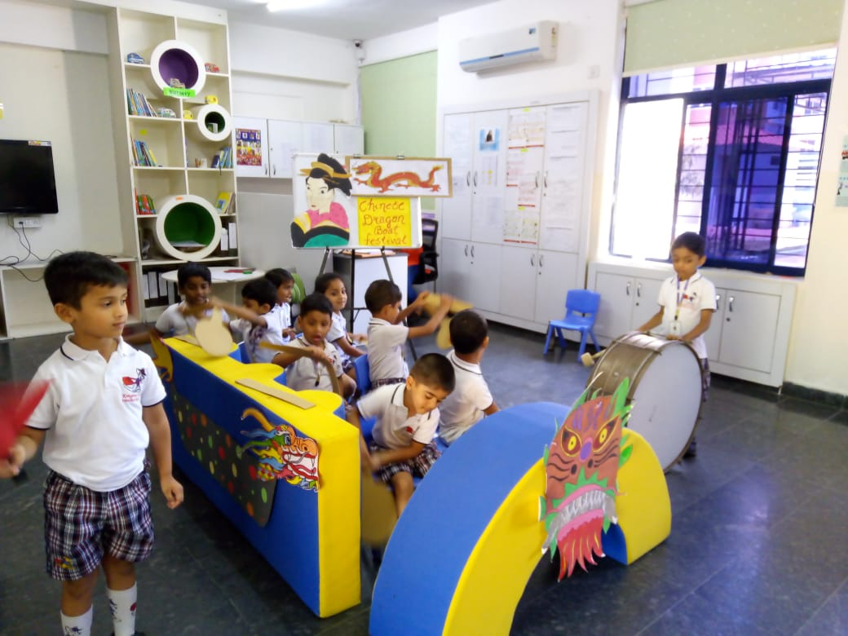
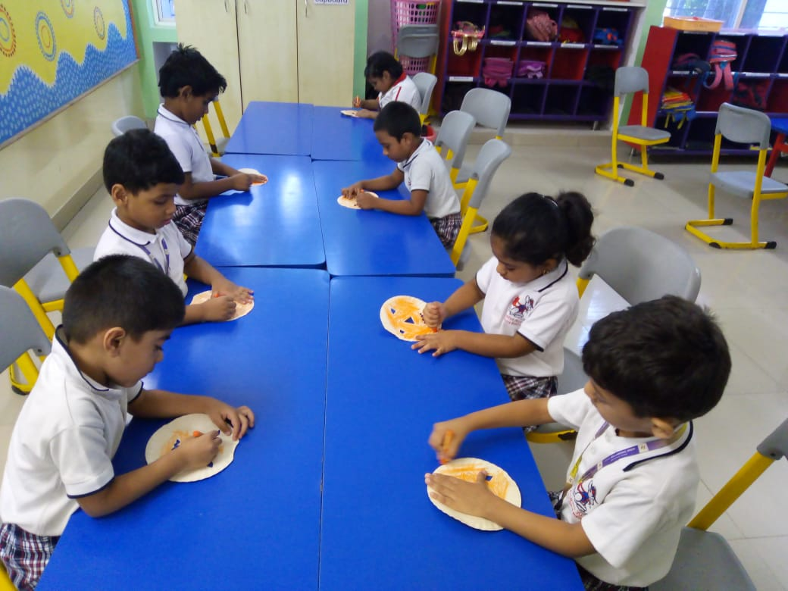
Sr.KG – Around the World
Theme for 3 Months

Slide 15
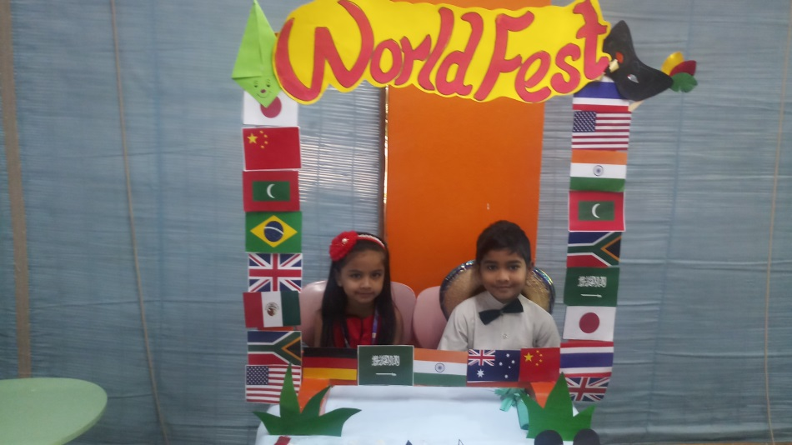
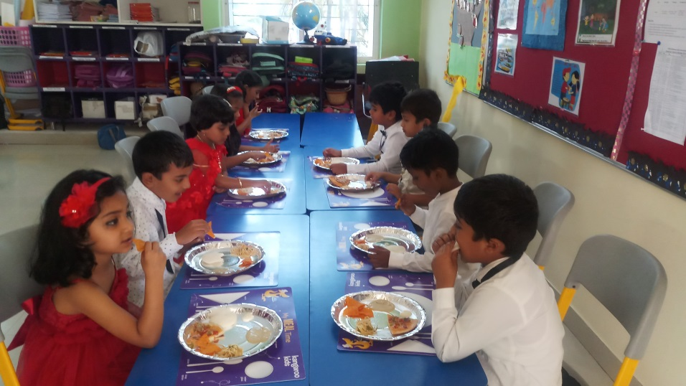
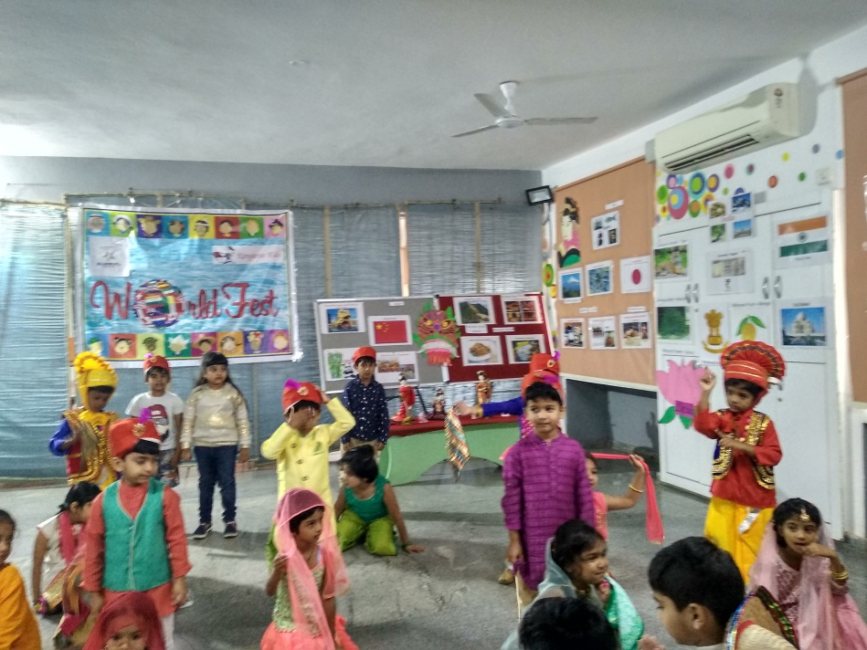
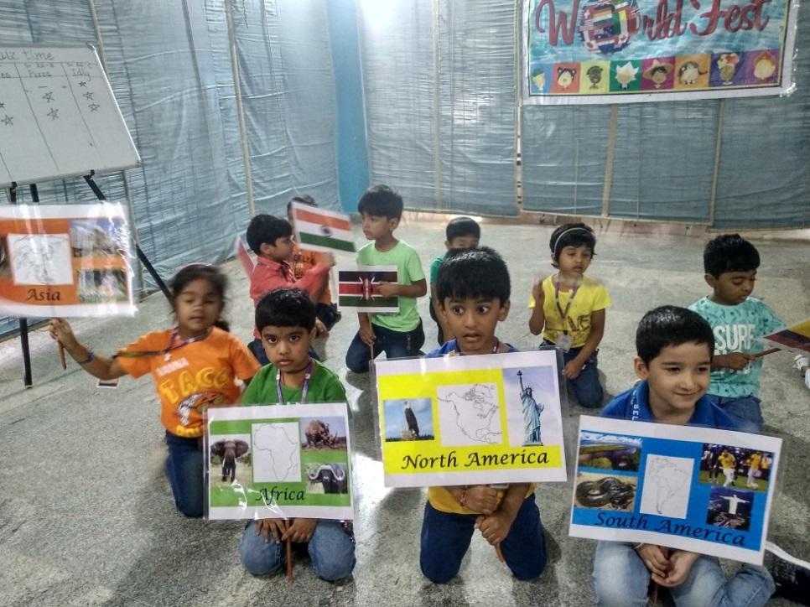
Sr.KG – World Fest 8.11.2019

Slide 16
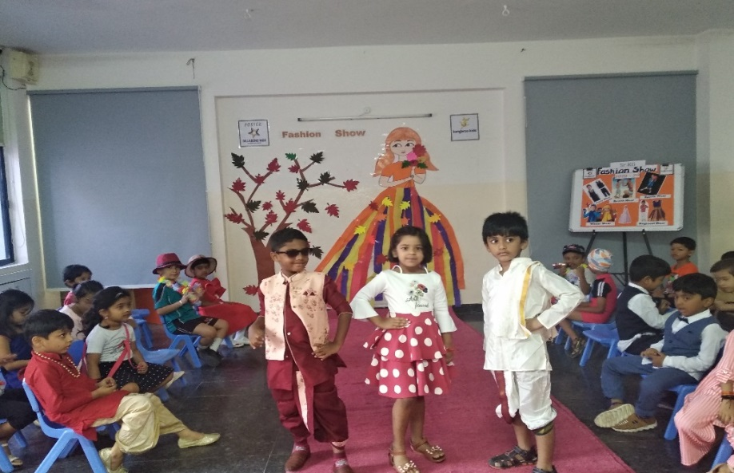
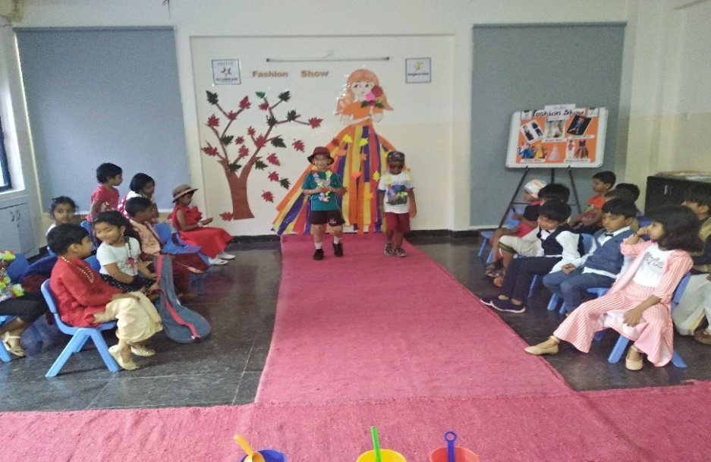
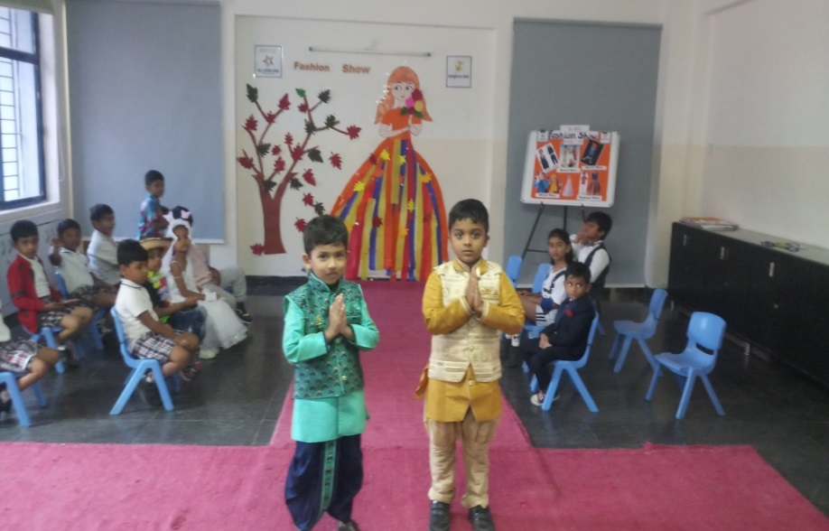
Sr.KG – Fashion Show 28.11.2019

Slide 17
Sr.KG Graduation Ceremony

Slide 18
Van Mahotsav 5.7.2019

Slide 19
Safe Touch and Unsafe Touch
26.7.2019

Slide 20
Eco Friendly Ganesha 29.8.2019

Slide 21
Hindi Diwas 13.9.2019

Slide 22
Grandparents Day 31.8.2019

Slide 23
Literary Week
9th to 16th September, 2019

Slide 24
International Yoga Day
21.6.2019

Slide 25
Advertisement Jingle &
Fancy Dress Show 21.9.2019

Slide 26
Traditional Day 25.11.2019

Slide 27
Children's Day 14.9.2019

Slide 28
Sports Day – 2019 – 20
5.9.2019

Slide 29
Story Day and Enactment Session

Slide 30
Sense Booth 7.12.2019

Slide 31
Event of the Year
Creepy Crawlies Day; 18.1.2020

Slide 32
PTA, PTM & Parent Volunteer

Slide 33
H.O. Visit, In-house Training

Slide 34
Childhood is a small window of time to learn and develop at a pace that’s right for each individual child

